Slide 1
Towards electron spectroscopy on a FAST ion beam at FLASH
Marko Förstel
Max-Planck-Institut für Plasmaphysik / für Kernphysik
AG Hergenhahn: U. Hergenhahn, M. Mucke, T. Arion, T. Lischke, H.-P. Rust, A. Bradshaw

Slide 2
Introduction
Overview of talk
The TIFF facility at FLASH
Ion fragment spectroscopy
Extension of TIFF and first experiments at FLASH
add electron spectroscopy
Experiments and tests at BESSY (introducing two)
New experiments and tests at TIFF
Planned experiments at FLASH
Notes:
Divide talk into 4 main sections
Starting point (TIFF) possible experiments (ion fragmentation on a fast beam -> neutral detection coinc measurements)
experimente at flash (TIFF and new spectrometer TIFF jr.)
Tests at BESSY and 2 experiments
New tests at TIFF using a fast ion beam

Slide 3
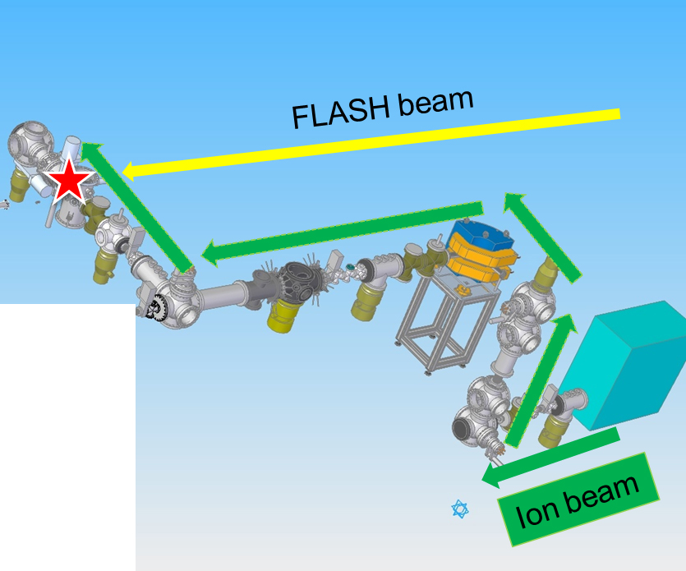
TIFF at FLASH
TIFF at FLASH
Mass selected targets
Fragment spectroscopy
Wide range of species which are otherwise not accessible
Fast beam -> neutral detection
05.02.2014
Notes:
TIFF makes fragment spectroscopy (WOLF PEDERSEN) already delivered nice results
Mass selected targets of a wide range of species which are not accessible in gas phase measurements
Neutrals detection because fast beam

Slide 4
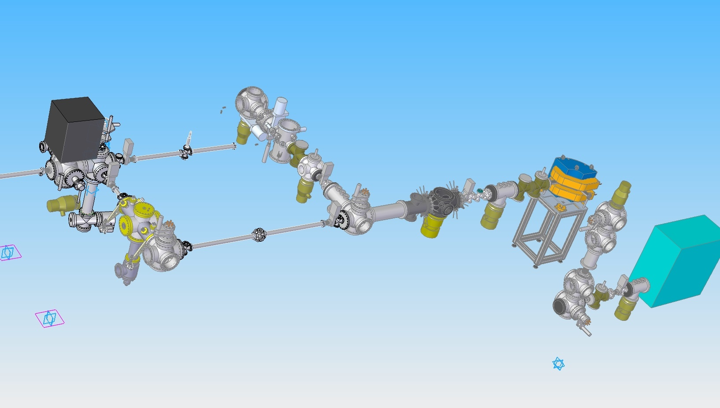
Extension of TIFF at FLASH with an electron spectrometer
TIFF Jr. and ESPEC
TIFF at FLASH
FLASH beam
add electron spectroscopy to existing setup
Switching of ion beam allows
two experiments on the same target
Ion beam
05.02.2014
Notes:
Extension build in coop with mpik
Electron spectroscopy
In cooperation with MPIK Added new electron spectrometer and TIFF.
new spectrometer planned at first IZ also

Slide 5
Extension of TIFF with an electron spectrometer
Alignment and comissioning of new setup in Hamburg
Achieved transmission of ions through TIFF jr. of about 80 %
Pressure in interaction chamber at about < 2*10⁻¹⁰ mBars (using MPIK bakeout computer)
05.02.2014

Slide 6
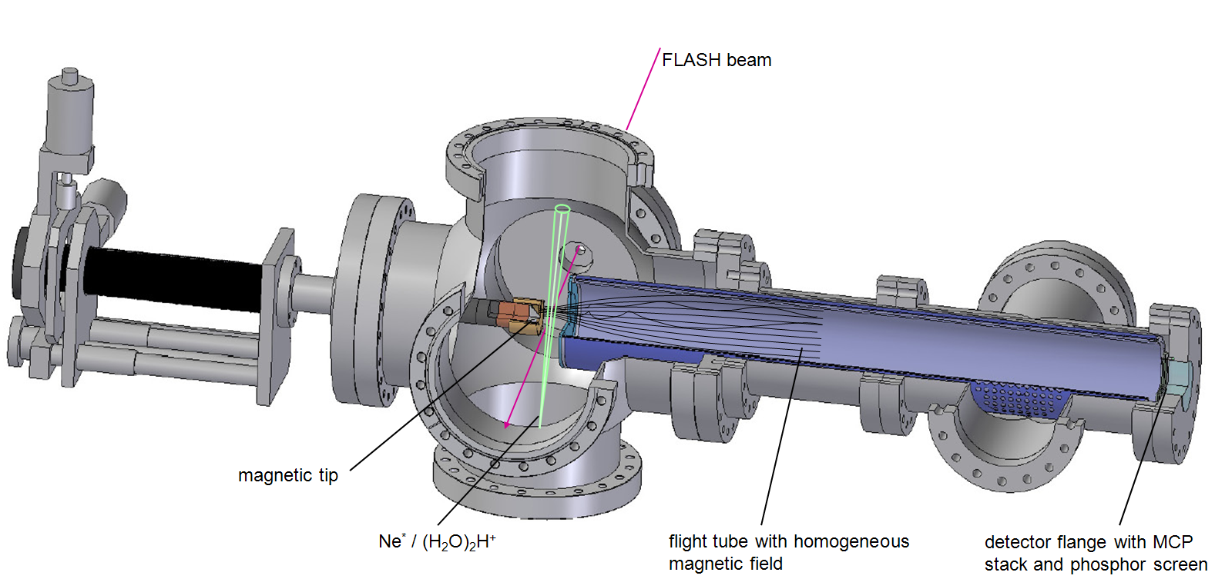
The electron spectrometer
05.02.2014
Notes:
-> überleitung zur electron interaction zone especially…
-> based on already existing spectrometers…

Slide 7
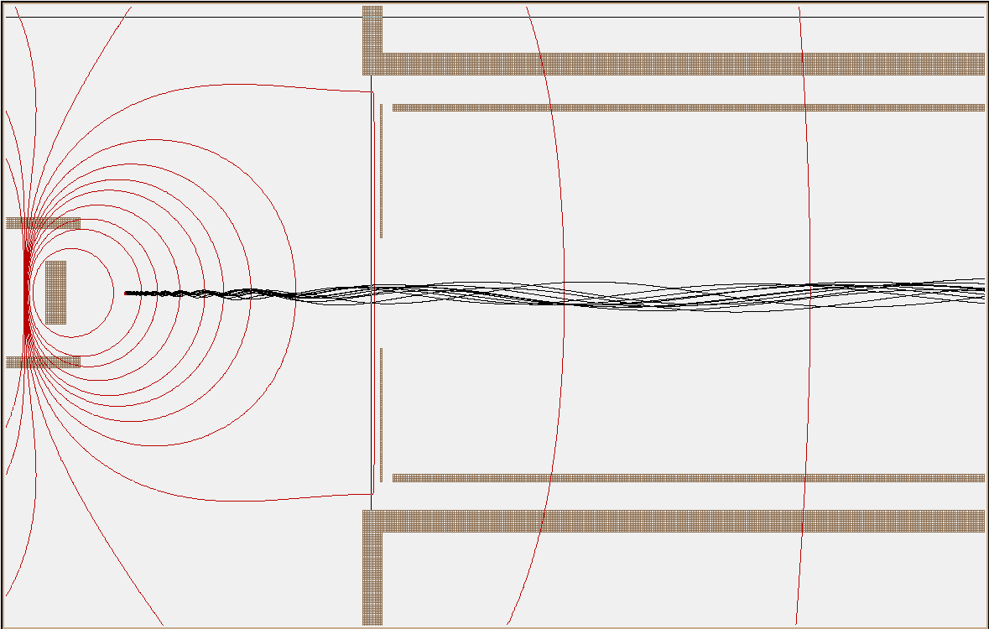
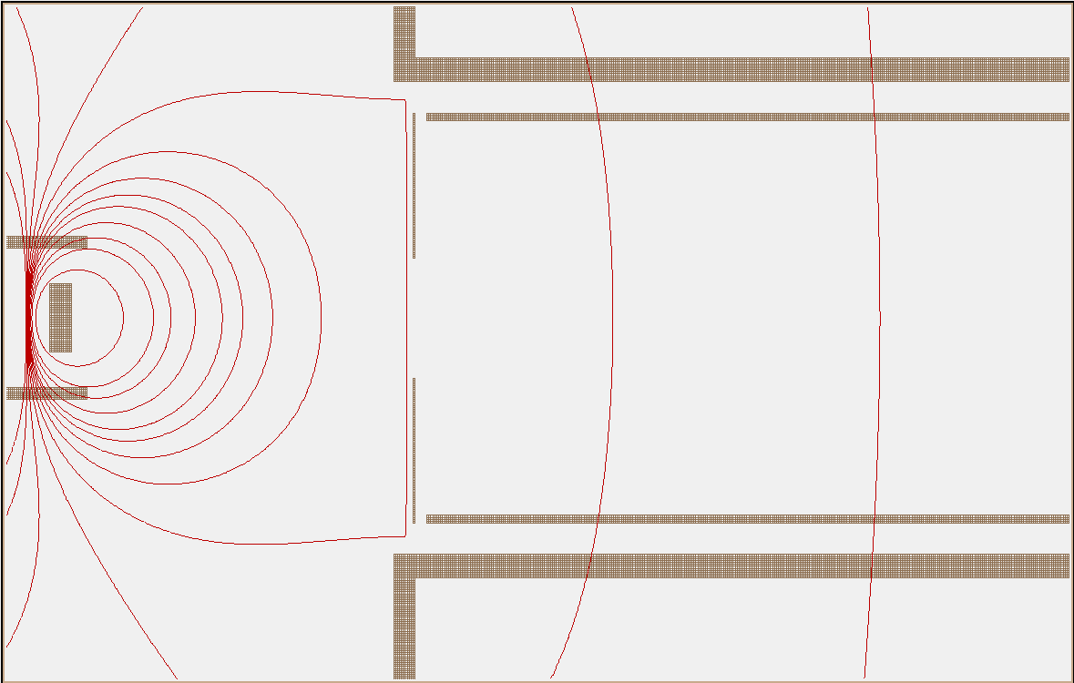
The electron spectrometer
ion beam
)
drifttube
FLASH
to detector
aperture
electron trajectories
magnet tip
magentic field lines perpendicular to drawn lines
05.02.2014
Notes:
-> picture sideways
→ Coltrims comparison: coltrims – allows calculation of trajectories -> momentum
-> bottle doesnt but:
-> higher energy electrons detectable (up to 1keV)
-> better resolution (E/dE = 20)

Slide 8
First experiments at FLASH
Parameters for FLASH experiment
Target | Estimated density in IZ in cm⁻³ | Estimated counts / s
Neon⁺ | 5*10⁵ (120 nA beam current) | 47
(H₂O)₃H⁺ | 1.5*10⁵ (40 nA beam) | 18
Residual gas (mainly H₂ and H₂O) | 8*10⁶ (at 3*10⁻¹⁰ mBar pressure) | 514
Assuming:
Integrated photon flux = 1.03 *10¹⁴ /s
Size interaction region = 0.4³ cm³
05.02.2014

Slide 9
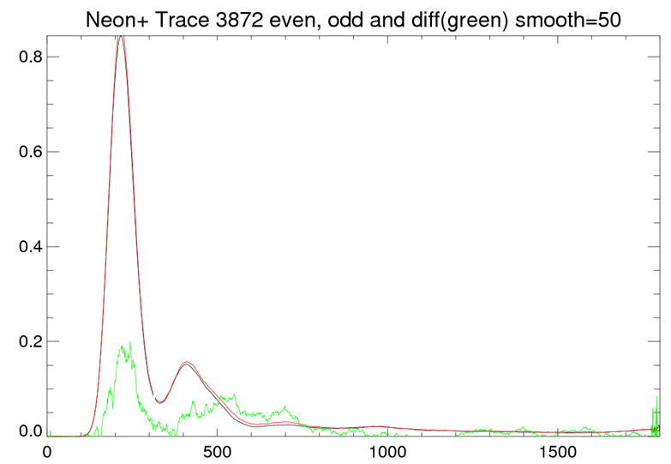
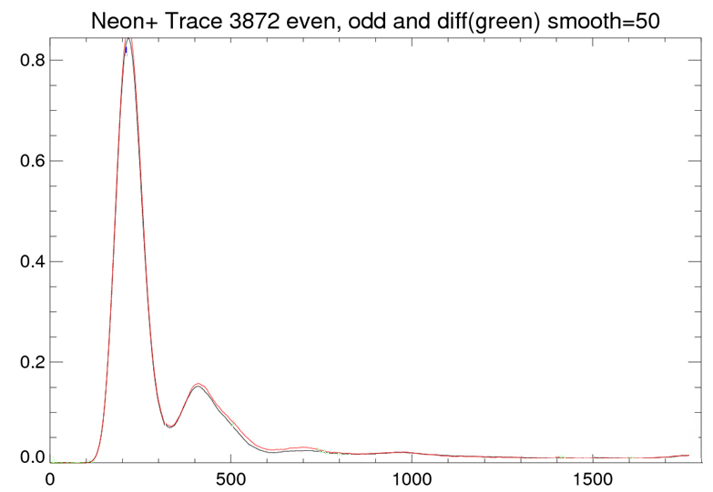
First experiments at FLASH
hv = 92 eV
Ne⁺ -> Ne²⁺
Black line = ion beam off
Red line = ion beam on
counts / arb. u.
green - difference
t.o.f. / channel #

Slide 10
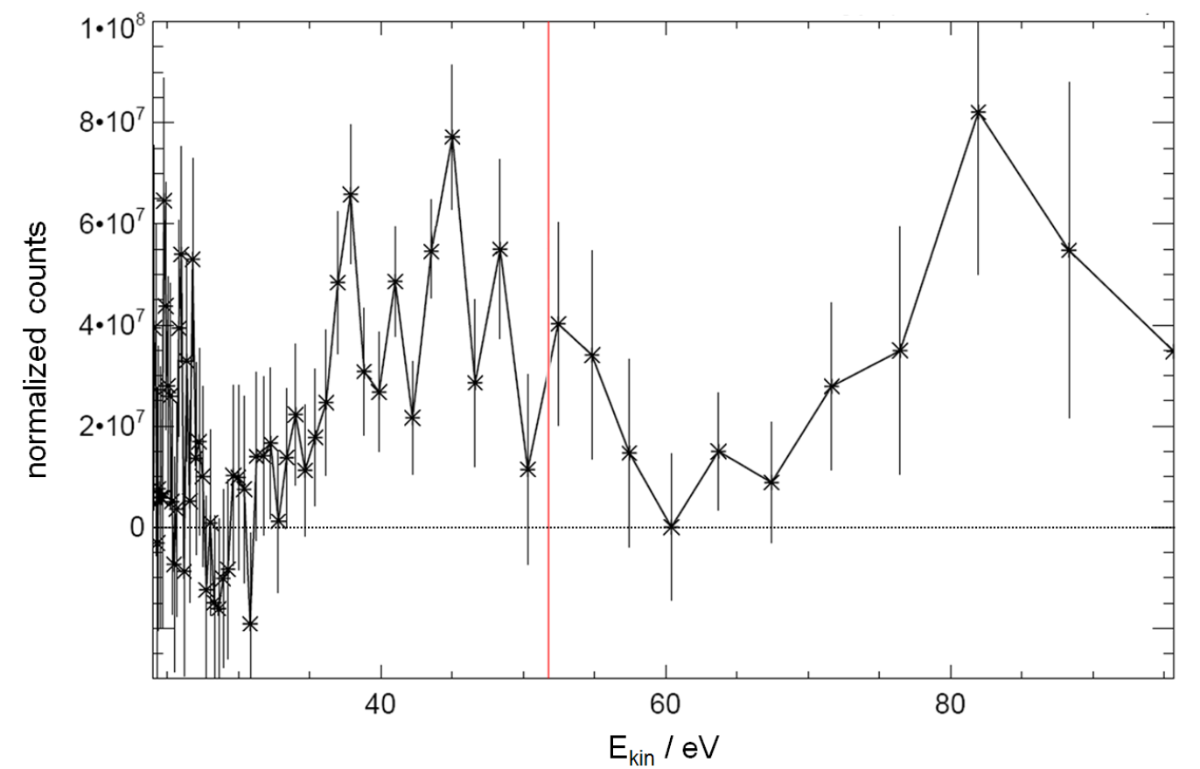
First experiments at FLASH
Neon⁺ ionization
Count rate 1 Hz
(47 expected)
First three doubly ionized states are seen
Notes:
subtracted. In an acquisition time of 1200 s we have recorded roughly 1200 events from the ion
beam. At kinetic energies between approx. 45 to 52 eV, the signal from ionization into the first
three doubly ionized states of Ne is expected. Figure 2 shows significant structure in this energy
region. The signal at higher kinetic energies was identified as FLASH ionization of residual water
desorbed from apparatus parts by the ion beam.
Figure 2: Electron spectra from a Ne+ ion beam recorded with a magnetic bottle spectrometer at FLASH (h
= 92 eV). The red line shows the expected kinetic energy for photoelectrons from ionization into the Ne2+
ground state.
-> hv = 92 eV
-> measured 0.5Hz (instead of two)

Slide 11
First experiments at FLASH - conclusions
Fragment spectroscopy successfull (TIFF IZ)
Feasibility in principle shown
Considerable improvements needed
Beam overlap and alignment procedure
Mag. bottle energy resolution
Vacuum improvements

Slide 12
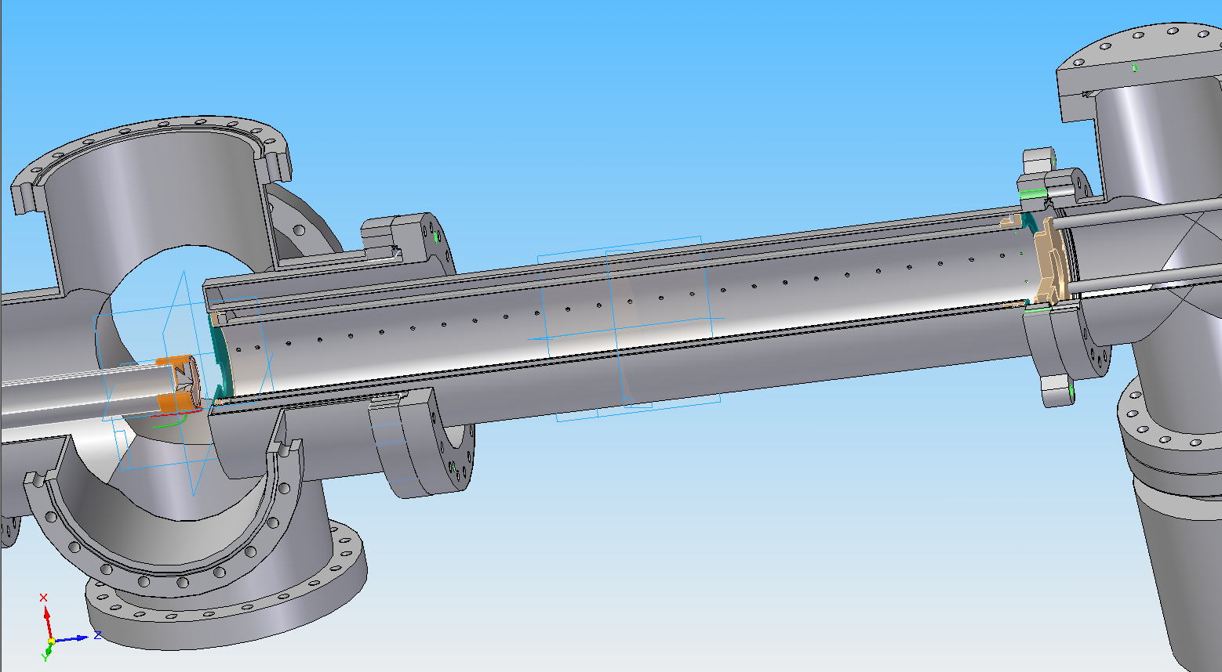
Experiments and tests at BESSY – a new spectrometer
Make new bottle and characterize it at BESSY…
coil outside the vacuum…
d = 76 m
smaller magnet tip…
Time structure: ‚Single bunch‘ (one e- packet, 800 ns gap)
05.02.2014

Slide 13
Tests and experiments at BESSY – argon band structure
Clusters
between atom (monomer) and bulk
how do physical properties change with size?
(melting point / structure…)
cluster specific properties?
what size makes a cluster „bulk“ like?
05.02.2014

Slide 14
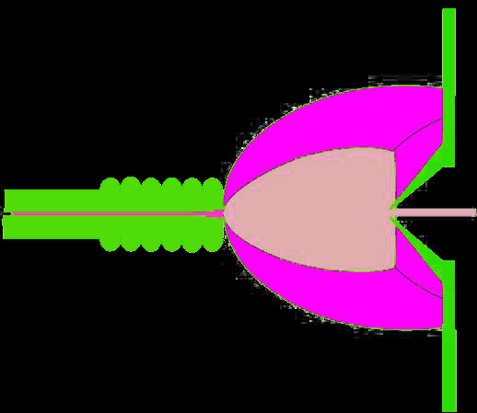
Tests and experiments at BESSY – argon band structure
Supersonic jet
expansion chamber
reaction chamber
nozzle
transversally cold, directed jet
direction of gas flow
skimmer
parameters:
stagnation pressure ~ some bars
nozzle temperature ~ 40-300 K p (exp. chamber) ~ 10⁻³ mbar
p (reaction chamber) ~ 10⁻⁶ mbar
05.02.2014
Notes:
- Scaling law parameters -> cluster size distribution

Slide 15
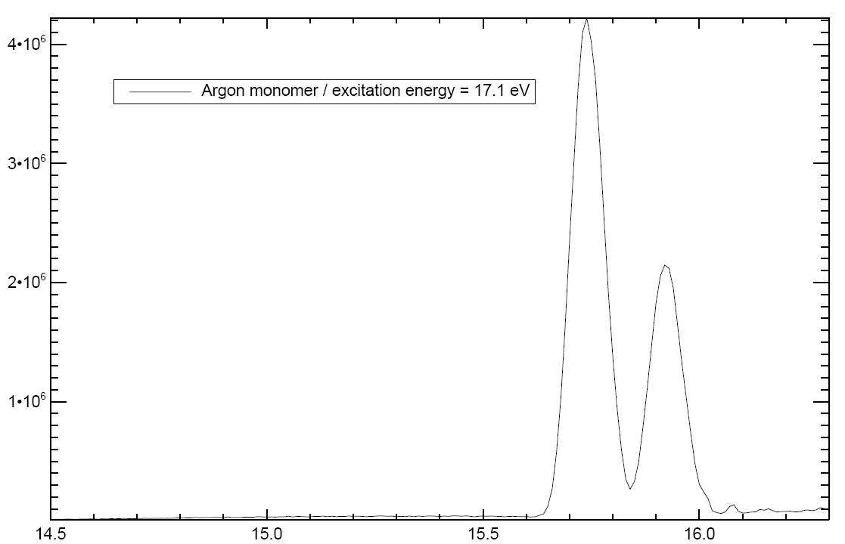
Tests and experiments at BESSY – argon band structure
Argon 3p Monomer
Monomer
Excitation energy = 17.1 eV
3p_{3/2}
3p_{1/2}
Normalized intensity / arb. u.
Binding energy / eV

Slide 16
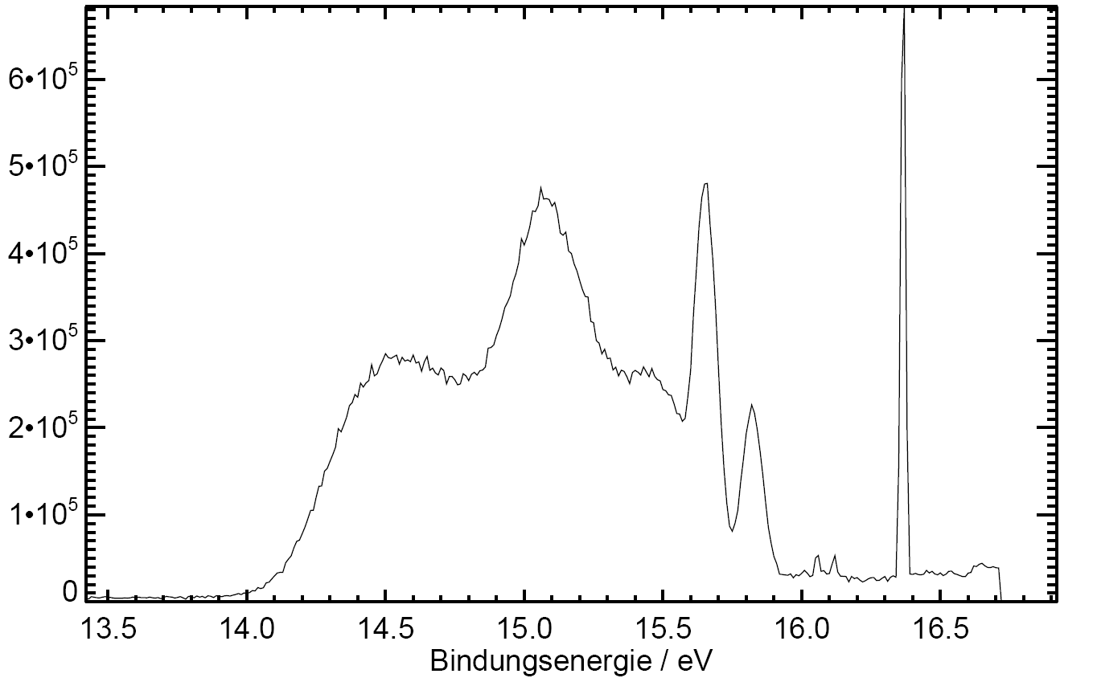
Tests and experiments at BESSY – argon band structure
Argon Cluster (<N> = 191)
Cluster + Monomer
Excitation energy = 17.1 eV
Normalized intensity / arb. u.
Binding energy / eV

Slide 17
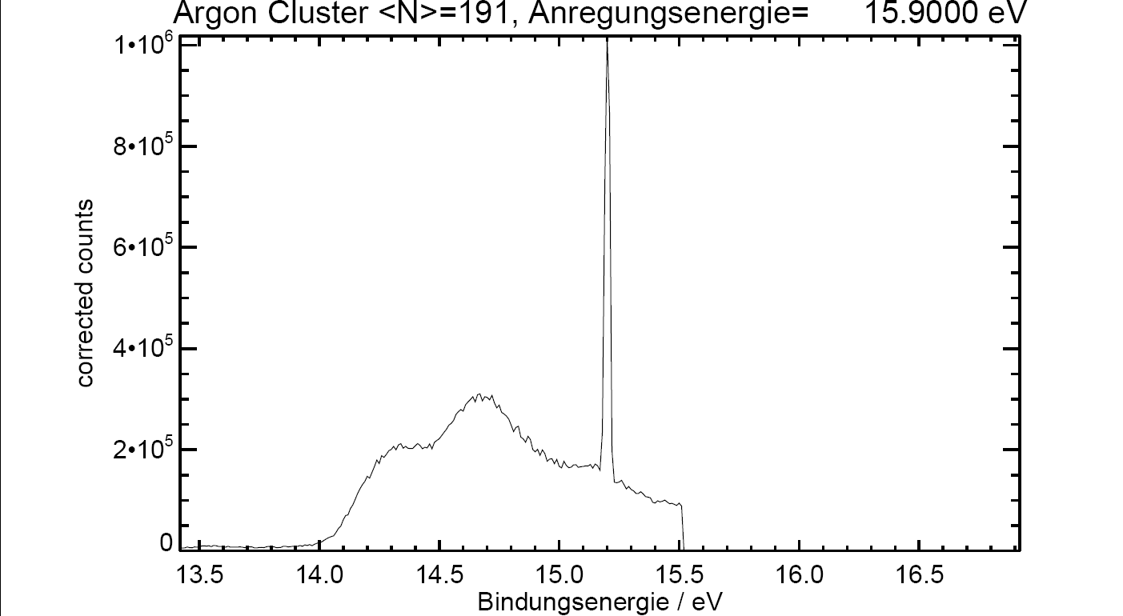
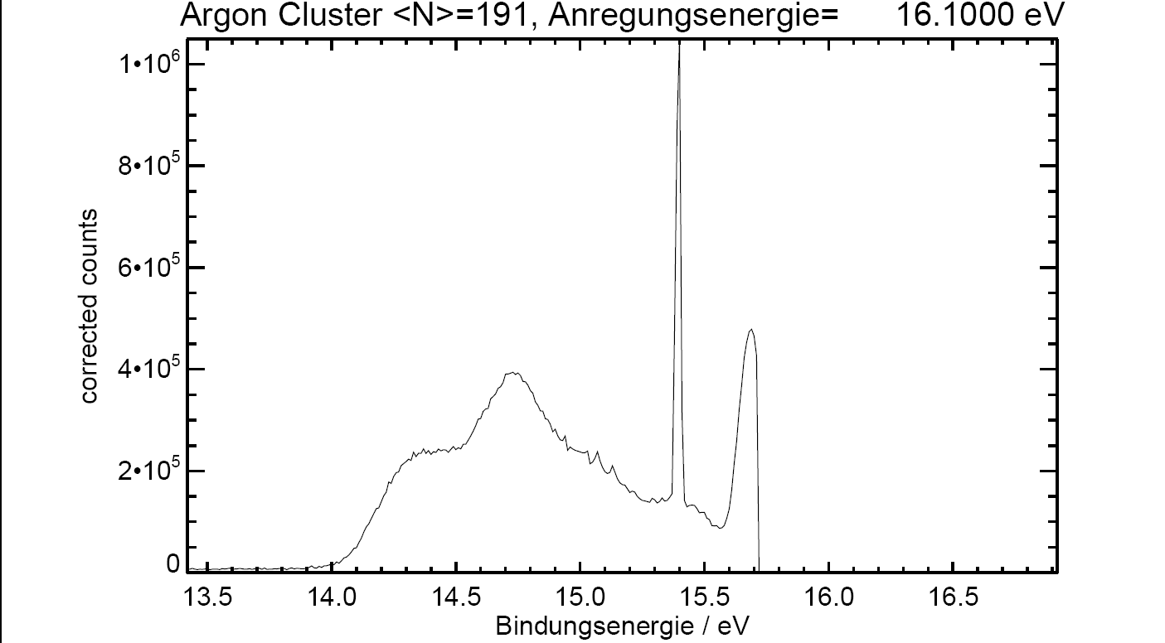
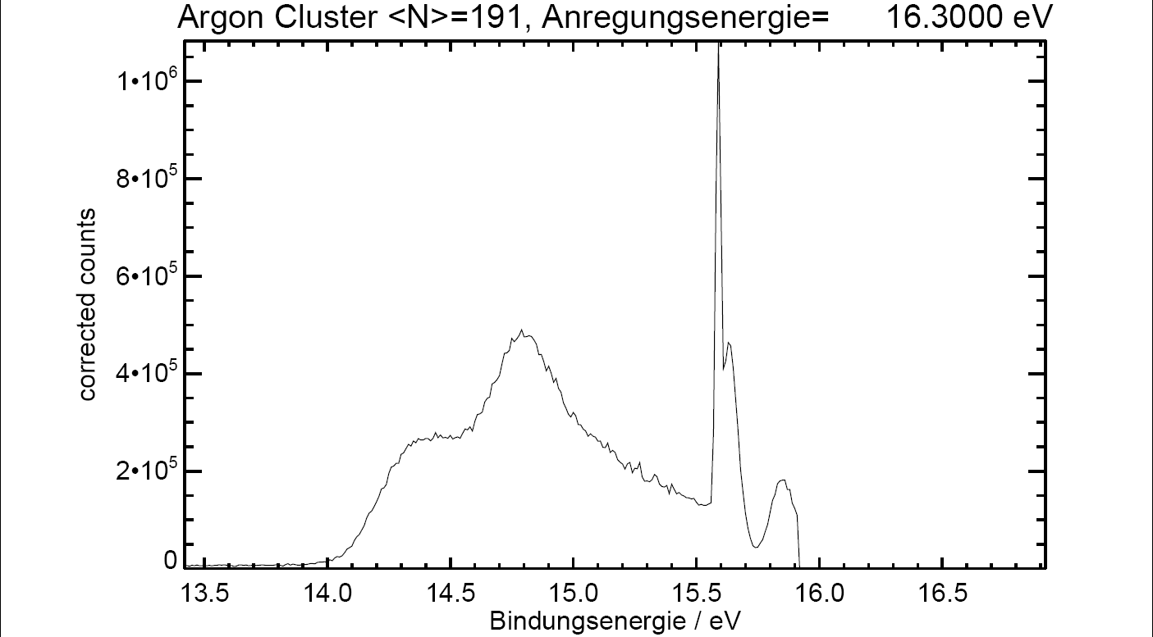
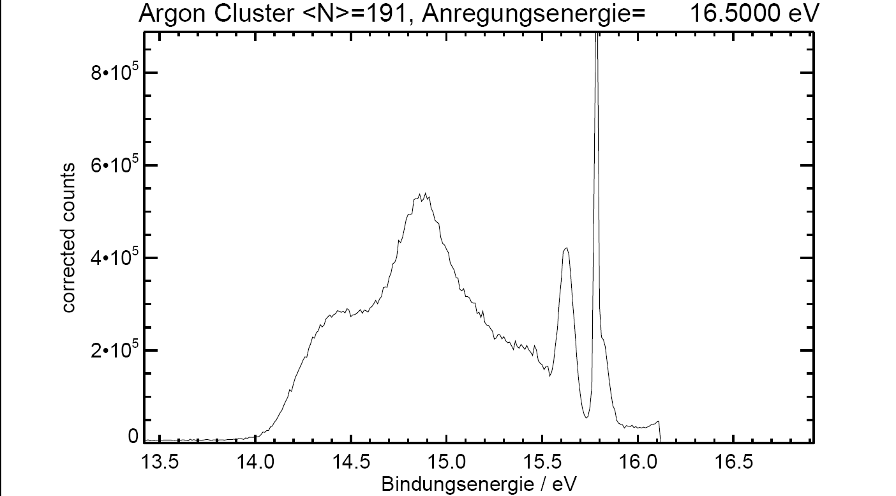
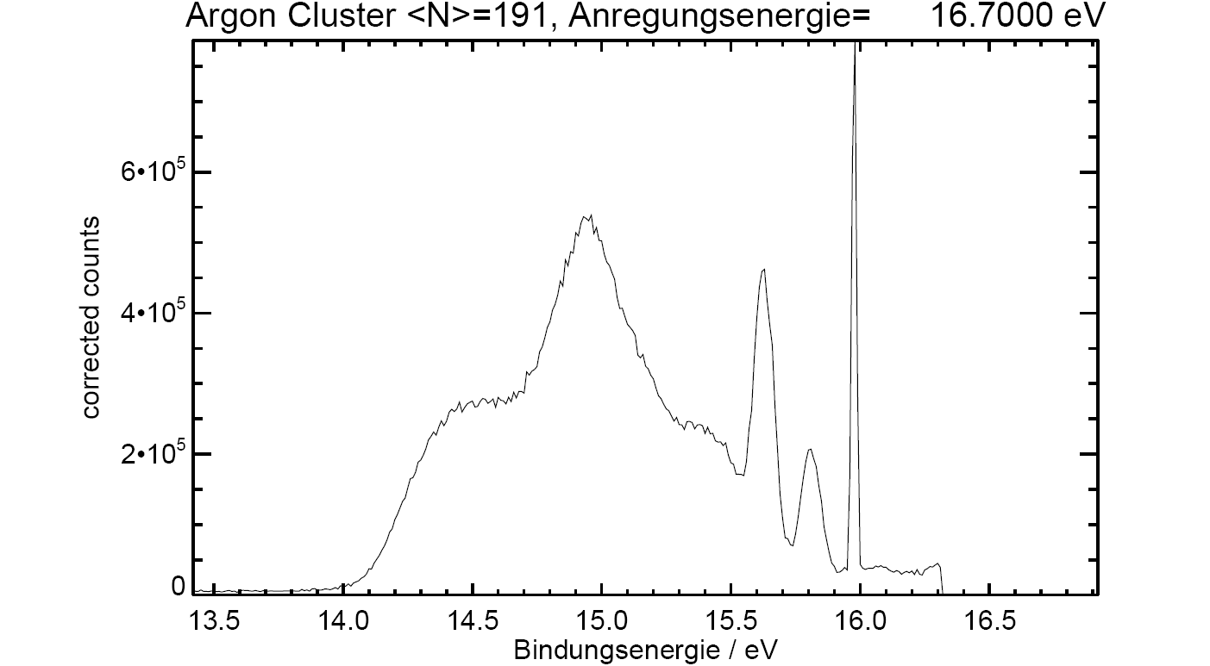
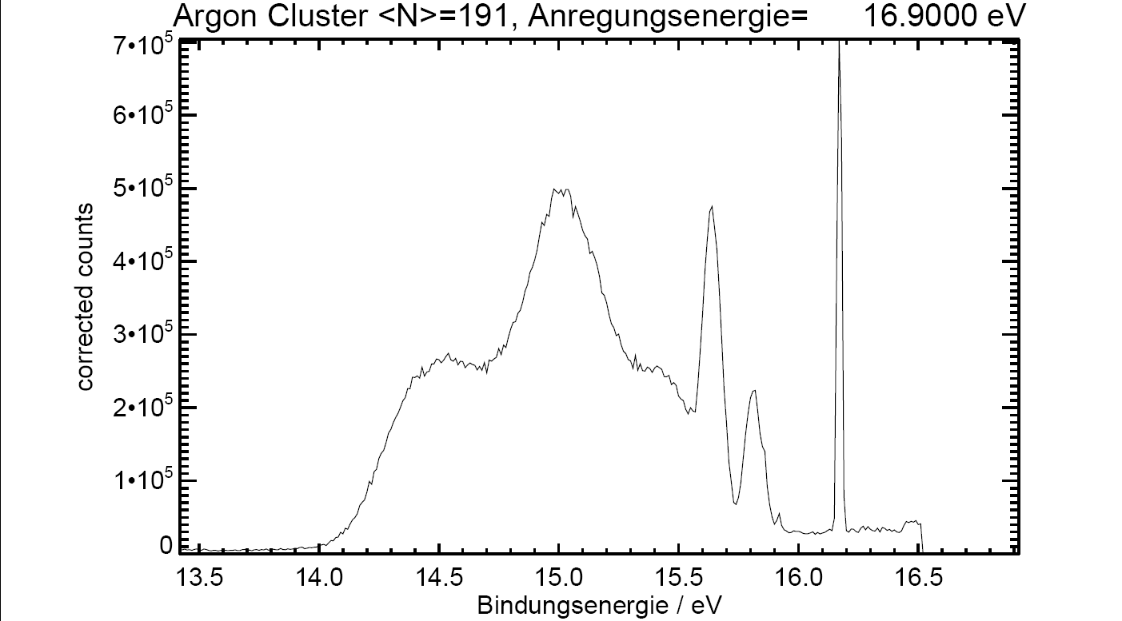
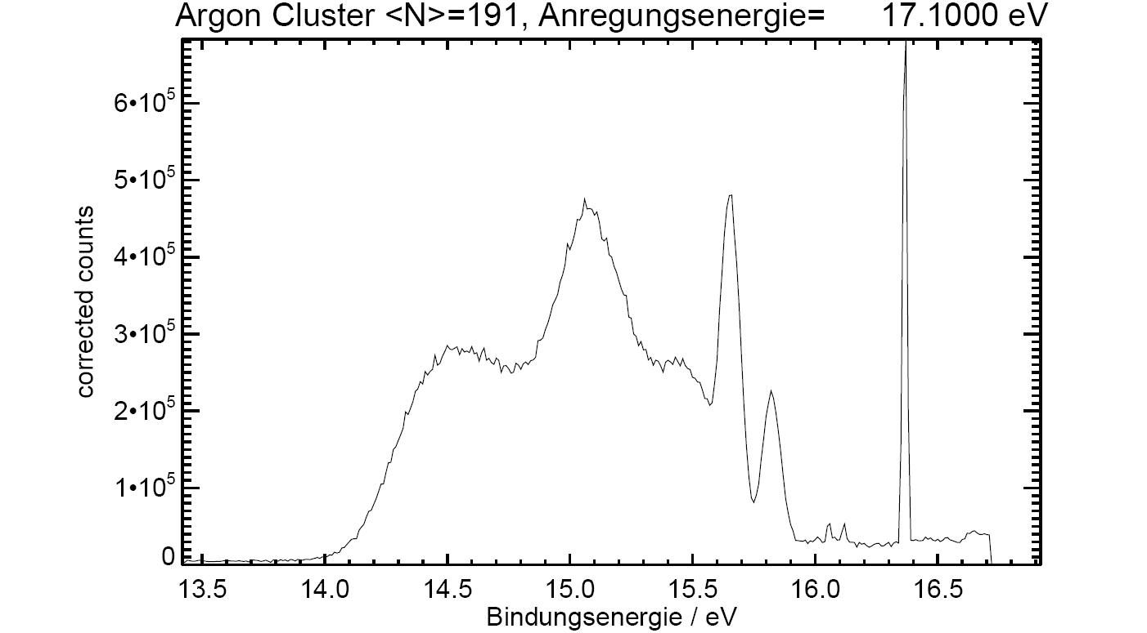
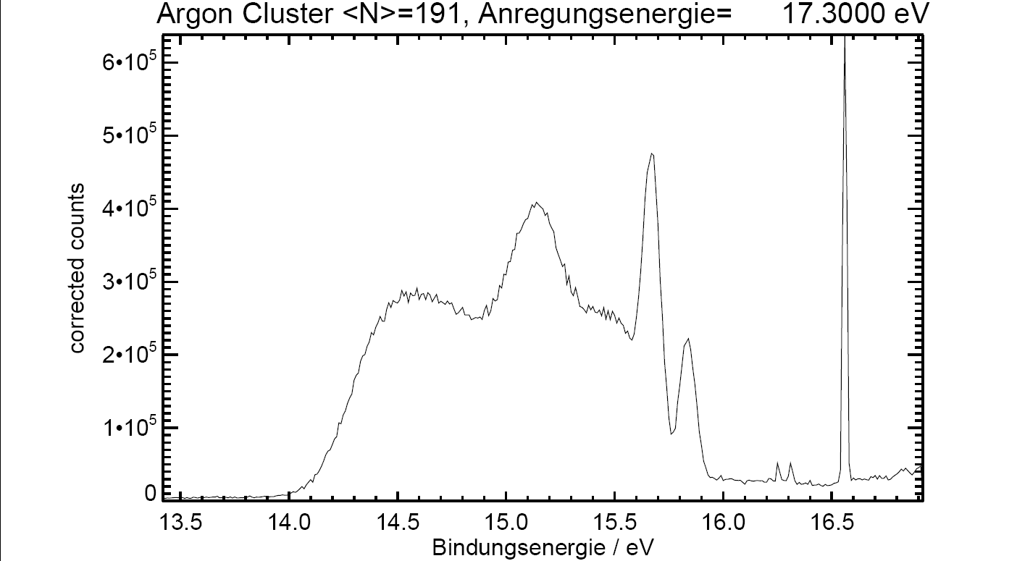
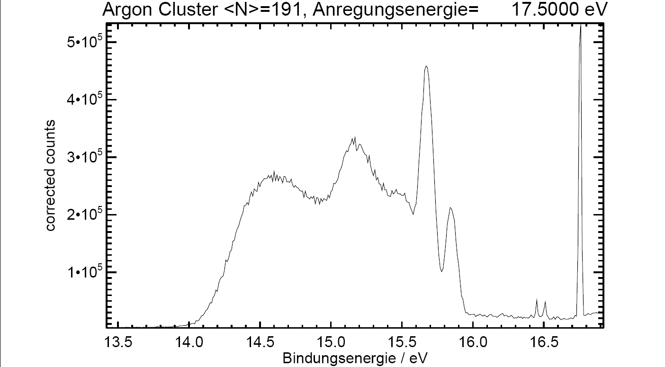
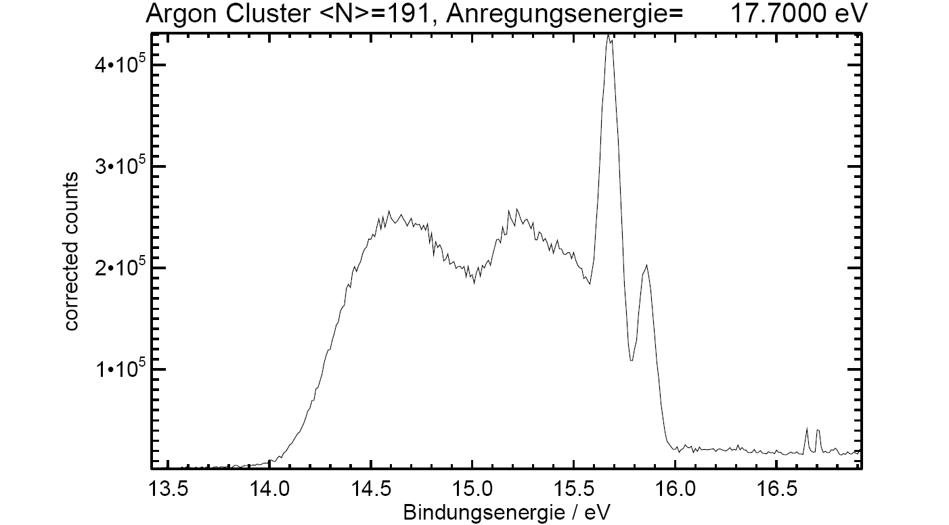
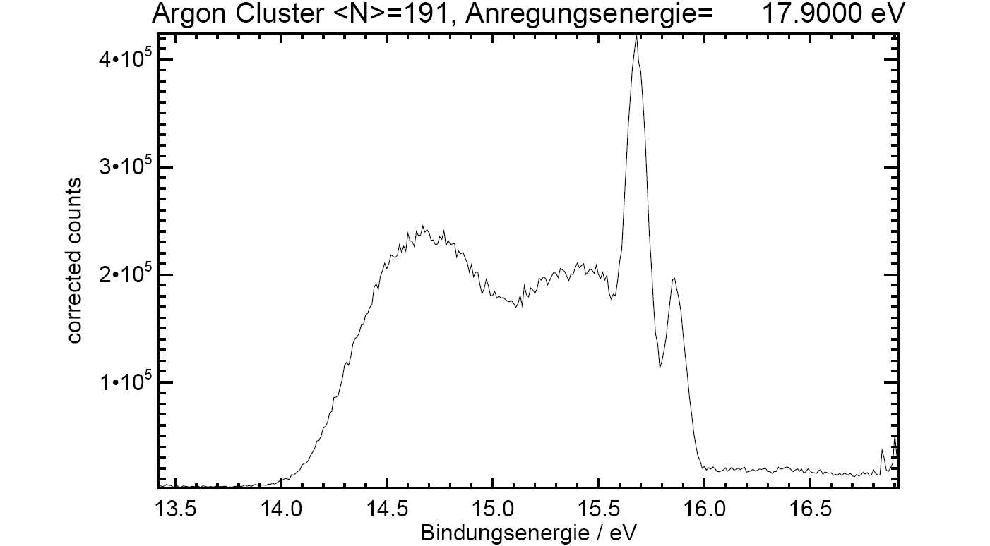
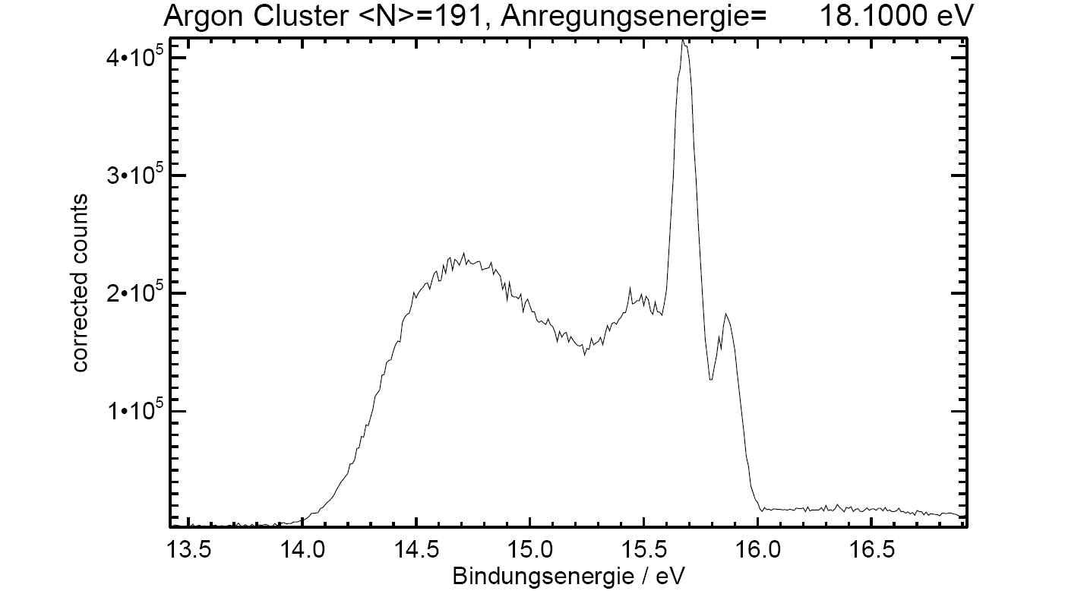
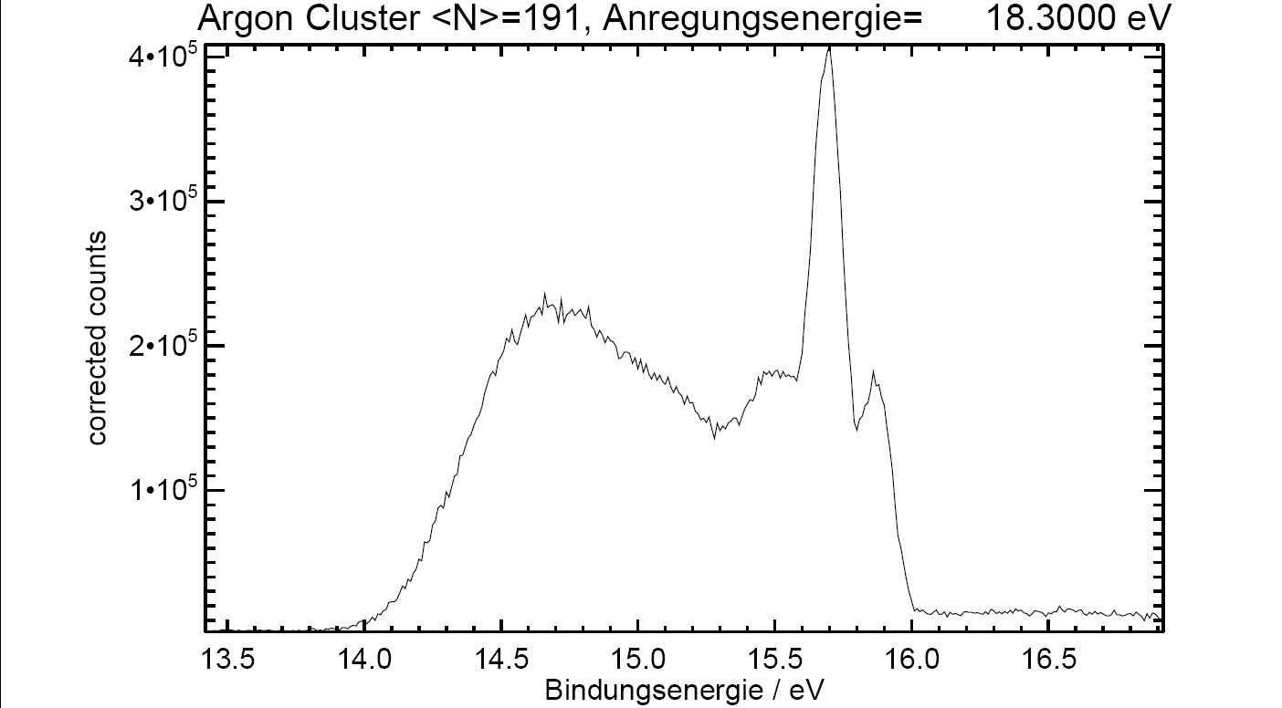
Tests and experiments at BESSY – argon band structure
Argon Cluster
dE = 0.7eV

Slide 18
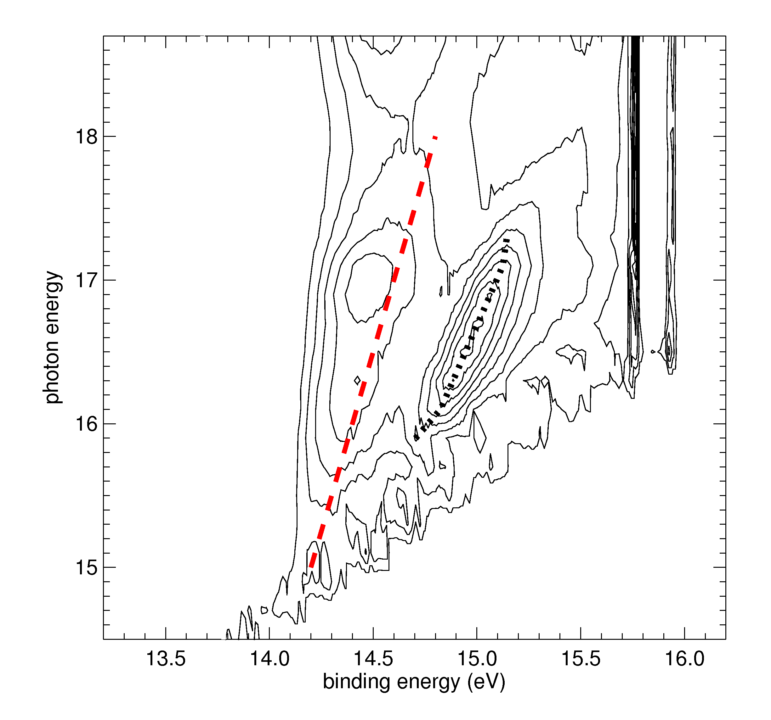
Tests and experiments at BESSY – argon band structure
Argon Cluster (<N> = 1700) using a hemispherical analyzer
Red line seen by
Feulner et al. (unpublished results)
on monocrystalline argon
Also visible on polycrystalline layers:
Schwentner et al. Phys. Rev. Lett. 34, 538 (1975)
05.02.2014

Slide 19
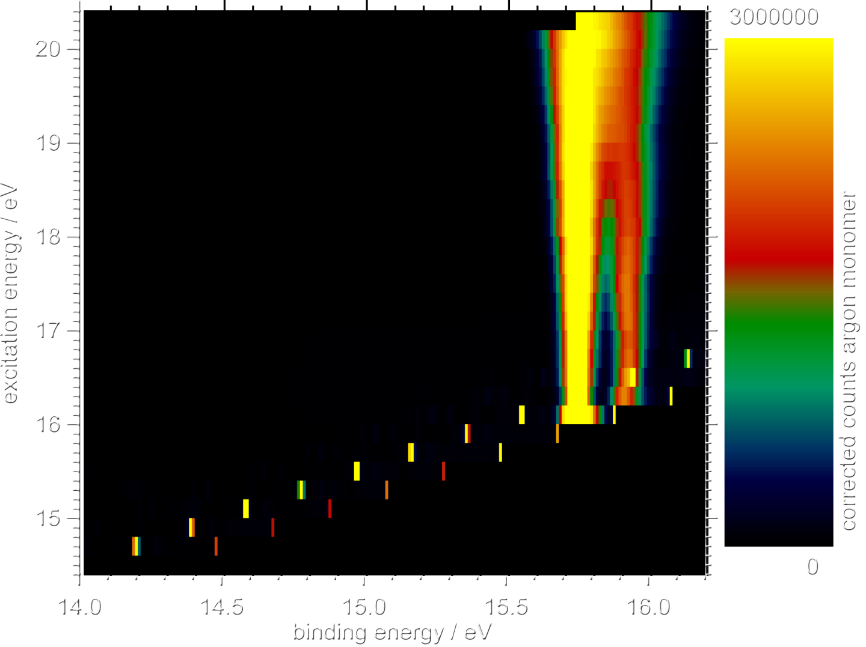
Tests and experiments at BESSY – argon band structure
Argon Monomer

Slide 20
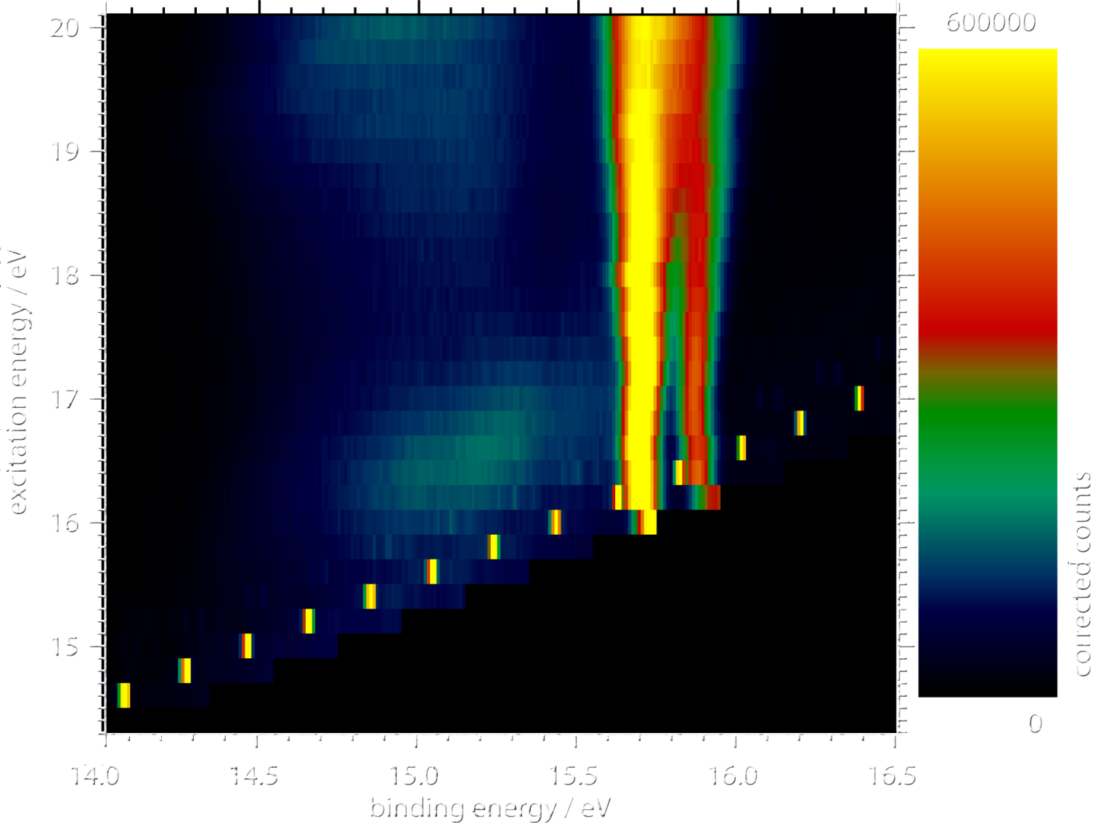
Tests and experiments at BESSY – argon band structure
Argon Cluster (<N> = 24)

Slide 21
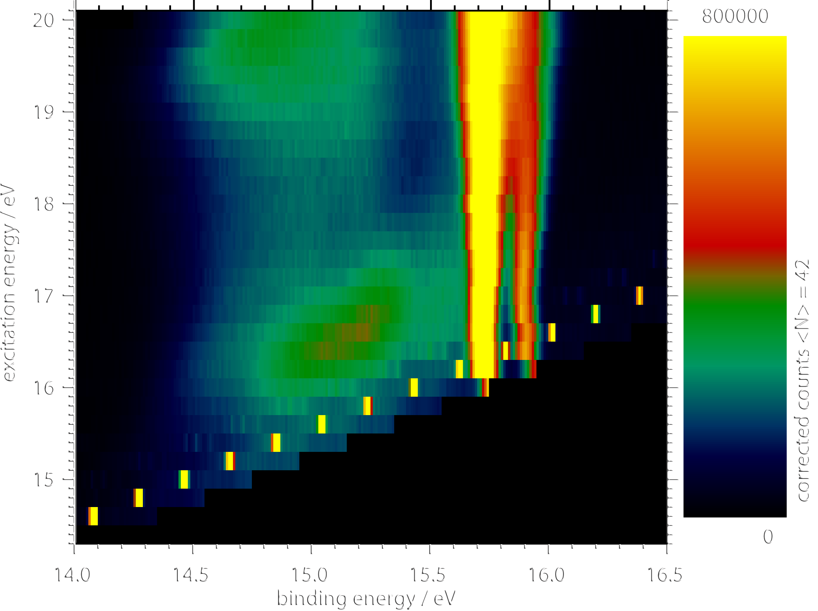
Tests and experiments at BESSY – argon band structure
Argon Cluster (<N> = 42)

Slide 22
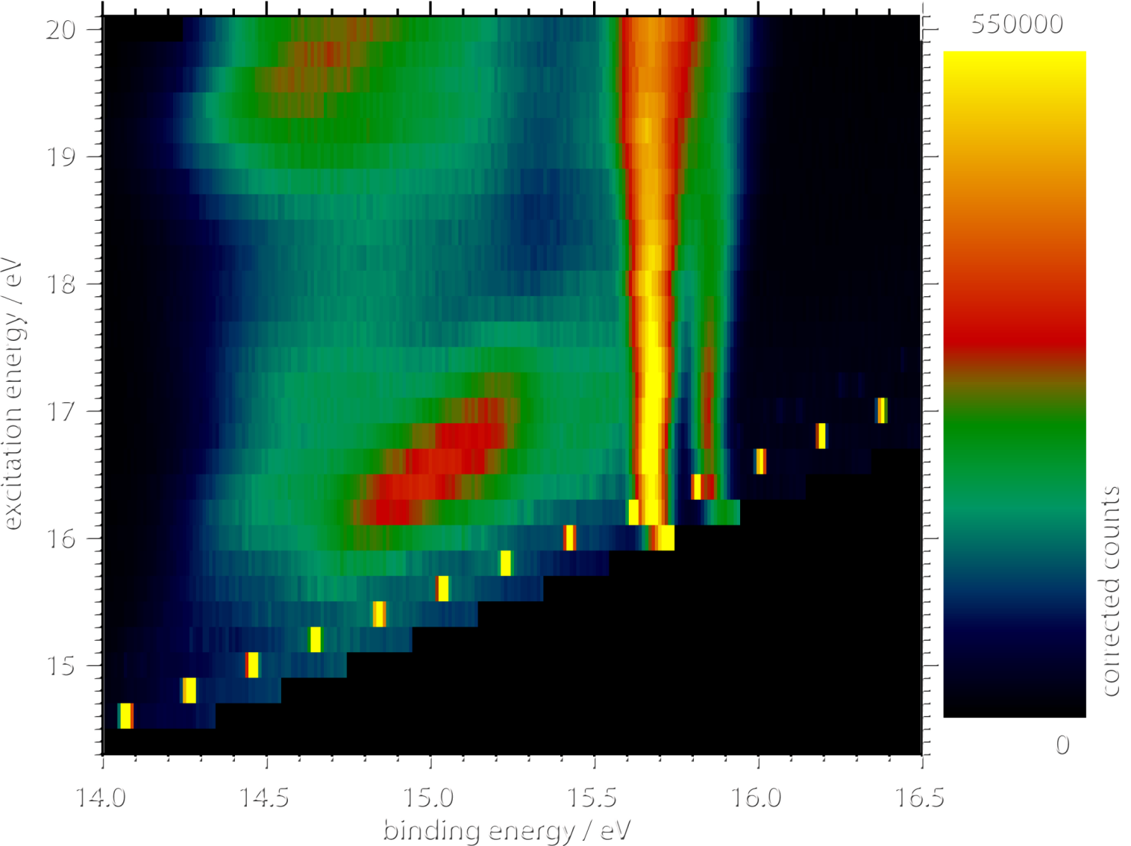
Tests and experiments at BESSY – argon band structure
Argon Cluster (<N> = 96)

Slide 23
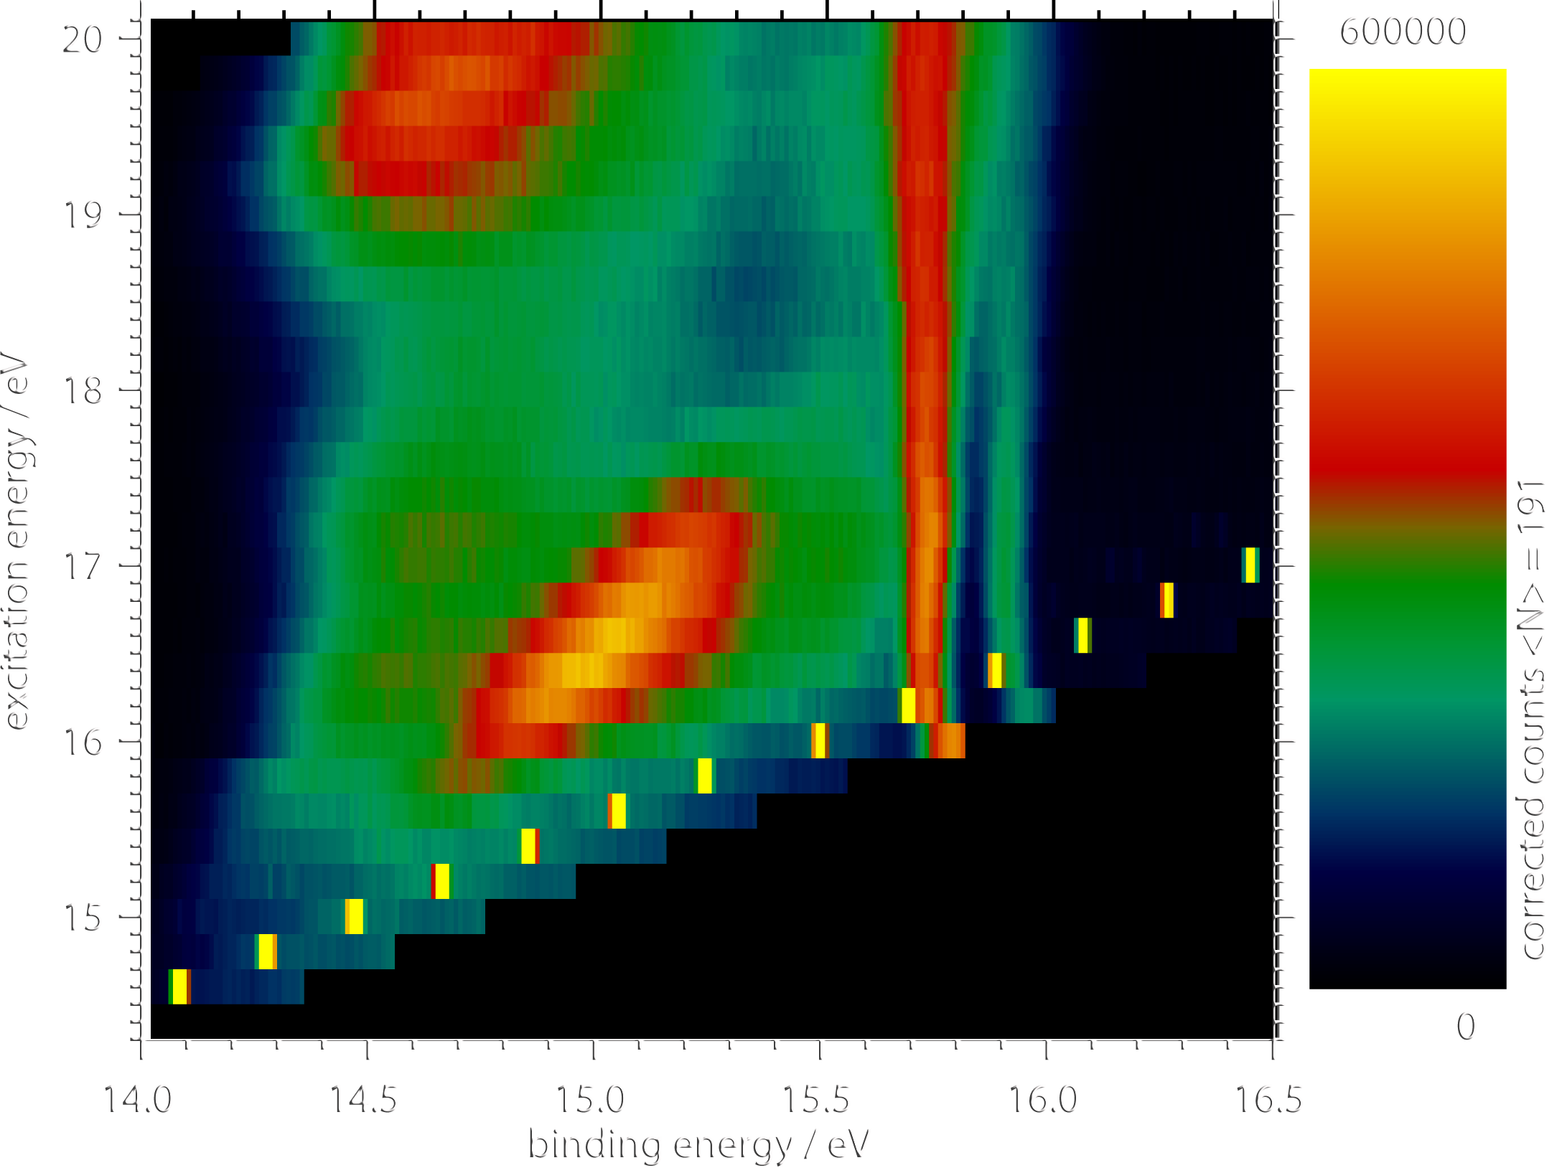
Tests and experiments at BESSY – argon band structure
Argon Cluster (<N> = 190)

Slide 24
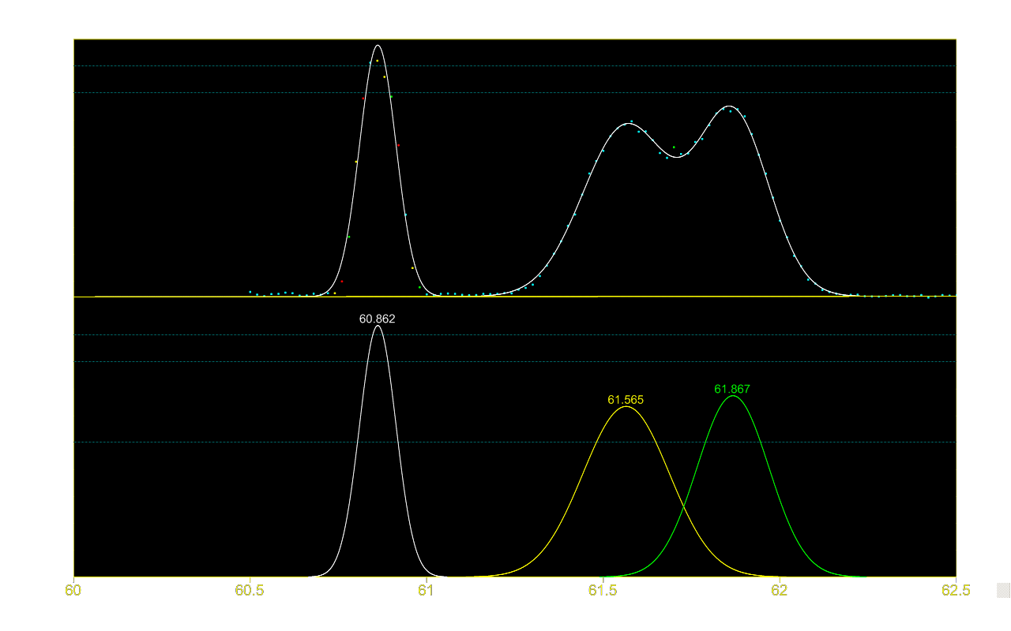
Tests and experiments at BESSY – argon band structure
Cluster size distribution according to Ar 3s bulk – surface ratio
Normalized intensity / arb. u.
Monomer
Surface
Volume
60
61
62
kinetic energy / eV
05.02.2014

Slide 25
Tests and experiments at BESSY – argon band structure
Comparison of the estimated sizes
<N> after scaling law | Measured area bulk to surface | <N> estimated from bulk to surface ratio
40 | 0.63 | 160
90 | 0.7 | 200
150 | 0.9 | 300
05.02.2014

Slide 26
Tests and experiments at BESSY – argon band structure
Band dispersion is already observed for very small clusters! (<N> ≈ 100)
experimentally seen for the first time
Dispersion is observed in unoriented systems
dispersion along ΓL, ΓX and other directions are very similar, or
only correctly oriented clusters are selected

Slide 27
Tests and experiments at BESSY
Bottle works fine for photoelectron spectroscopy
Energy resolution E/ΔE of about 20 achieved
Now what about electron - electron coincidences?
Tests made using for example Xenon NOO Auger decay
Will show more interesting experiment…
05.02.2014

Slide 28
Tests and experiments at BESSY – ETMD
ETMD so far only theoretically described
Two electrons are generated
Coincidence measurement!
Two ionic fragments
In Ar-Kr other channels are supressed (ICD)
ETMD(3)
Notes:
-> electron transfer mediated decay
-> is a nonlocal autoionization process (like better known ICD)

Slide 29
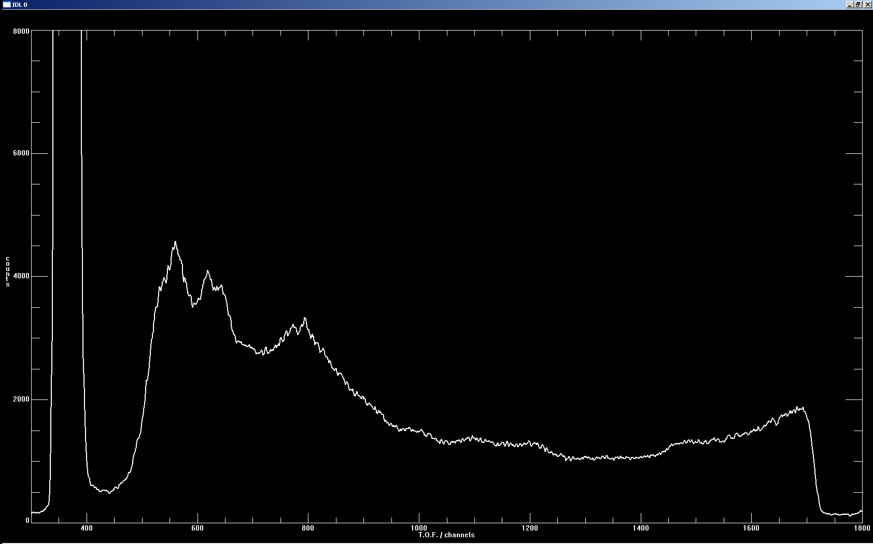
Tests and experiments at BESSY – ETMD
Ar-Kr cluster (5% Kr coexpansion) hv = 37eV
Ar 3p
Kr 4s
Ar 3s
counts
Kr 4p
Ar 3s bulk and surface
T.O.F. / channel
05.02.2014

Slide 30
Tests and experiments at BESSY – ETMD
Clusters: Kr core, Ar shell
Coincidence Counts
Ar 3p inelastic scattering
Ar 3s cluster component
time-of-flight (electron 1)
Ar 3p (random coinc.)
time-of-flight (electron 2)
05.02.2014
Notes:
Event based selection
draw first electron tof vs second electron tof

Slide 31
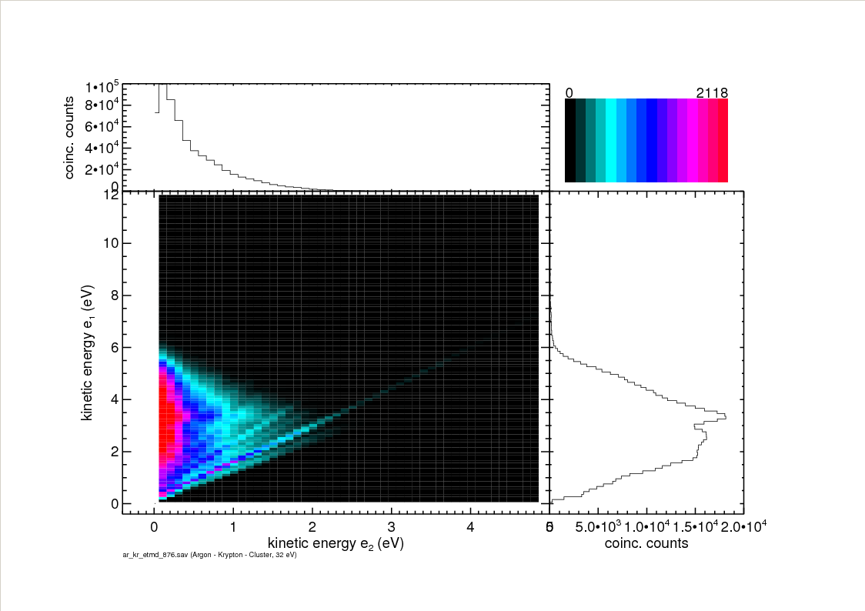
Tests and experiments at BESSY – ETMD
Preliminary
hv = 32eV
05.02.2014

Slide 32
Tests and experiments at BESSY – ETMD
First direct spectroscopic observation of ETMD
High detection efficiency (almost 4π acceptance angle)
Detection of low kinetic energy electrons
Very well suited for coincidence measurements…
05.02.2014

Slide 33
New experiments and tests at TIFF
back to TIFF to test improvements
So far resting target..
Ion beam (E_kin around 4400eV)
Measurements at TIFF using an optical laser system
Magnetic bottle plus neutral detector behind interaction region
electron – neutral coincidences
05.02.2014

Slide 34
New experiments and tests at TIFF
back to TIFF to test improvements using OH⁻ beam
New beamfinder and overlap finding procedure
Improved electron spectrometer
Countrates (normalized to photon flux from optical laser / target density):
Light source | Expected countrate | Achieved countrate
optical laser | 15 Hz | 10 - 15 Hz
FLASH | 0.7 Hz | 0.015 Hz
FLASH upgrade | 19 Hz | -

Slide 35
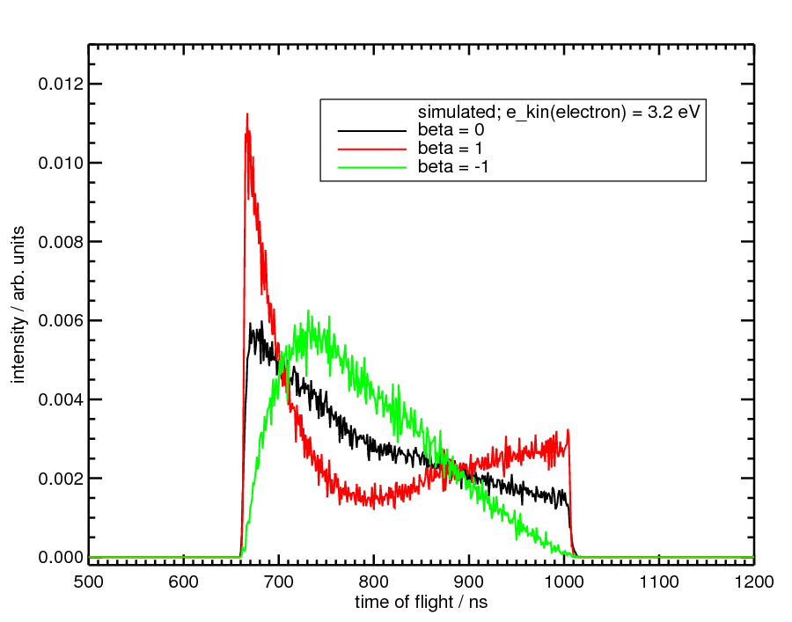
New experiments and tests at TIFF
electron
Electron velocity due to Doppler shift =
|v_{e}|=sqrt(|v_{ei}|²+|v_{i}|²+2cos(α)|v_{ei}||v_{i}|)
With v_{ei} = electron velocity as seen from
resting target
α
Ion beam (v_{i})
Additionally:
Electron angular distribution =
P(α,β)dcos(α)=[0.5- β/4+0.75 βcos²(α)]dcos(α)
With β = anisotropy parameter
05.02.2014
Notes:
-> linearly polarized light in ion beam plane

Slide 36
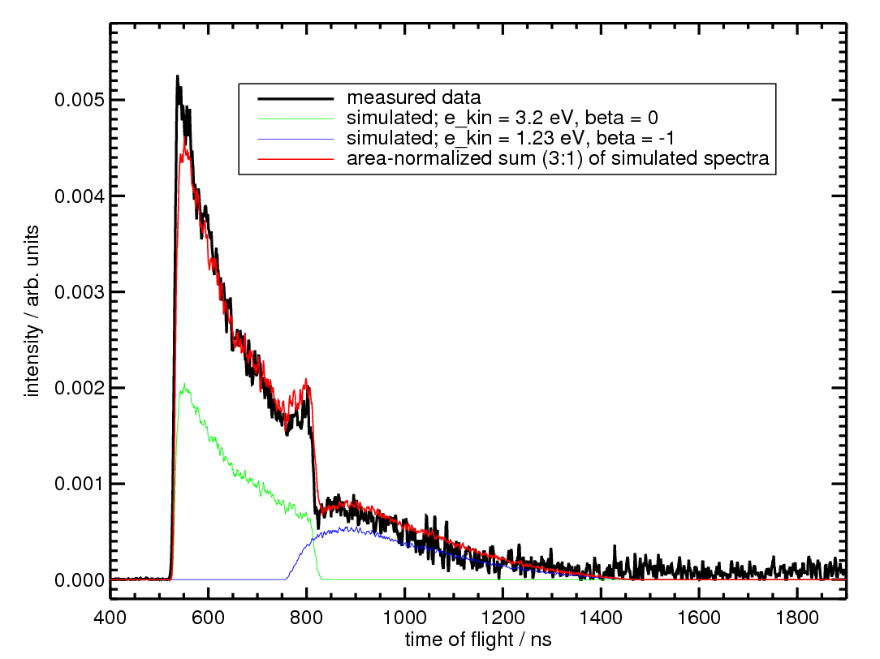
New experiments and tests at TIFF
Test this on O⁻
266nm (4.7 eV) / 10 Hz laser
~ 4400 eV / 3 nA ion beam
²P
¹D
³P
1.23eV
3.23eV
hv + O⁻
O +
e⁻
05.02.2014
Notes:
Mention that spectra SIMULATED

Slide 37
New experiments and tests at TIFF
Fast ion beam experiments with magnetic bottle well manageable
Countrates of up to 15Hz with laser intensity comparable to that of FLASH
Doppler shift plus 4π detection angle even allow direct measurement of beta parameters
Neutral detector allows coinc. measurements…
05.02.2014

Slide 38
Planned experiments at FLASH
Beamtime at FLASH end of 2010
proposed targets:
(H₂O)_{n}H⁺
Photoelectron spectra of mass selected clusters!
characterization of autoionization processes (ICD)
Future targets:
(H₂O)_{n}⁻
(H₂O)_{n}Li⁺
05.02.2014

Slide 39
Planned experiments at FLASH
Improvements…:
optical laser plus FLASH (alignment of bottle and beams)
improved resolution of mag. bottle
neutral detector for coinc analysis (BG reduction)
new beamfinder based on experiences gained with anion experiments
improved vacuum setup
interpretation supported by simulations
FLASH improvements:
higher intensity (up to 100 μJ (was 20))
more bunches (100 μBunches (was 30) )
higher rep. rate (10Hz (was 5))
05.02.2014

Slide 40
Acknowledgements
FLASH experiments and
electron detachment:
C. Domesle
B. Jordon-Thaden
S. Klumpp
L. Lammich
M. Martins
H. B. Pedersen
A. Wolf
FLASH TEAM
Argon Bands:
O. Björneholm
P. Feulner
K. Horn
D. Menzel
G. Öhrwall
M. Scheffler
A. Stampfl
G.P. Williams
BESSY SUPPORT
Our Group:
T. Arion
S. Barth
A. Bradshaw
U. Hergenhahn
T. Lischke
M. Mucke
H.-P. Rust
V. Ullrich
ETMD:
L.S. Cederbaum
N. Sisourat
BESSY SUPPORT
Financial support:
DFG
ASG der MPG
Fonds der chem. Industrie

Slide 41
THE END

